Slide 1
Breast Cancer Detection Using Support Vector Machine
Capstone Project
Lavanya Ramaswamy, Arun Sasidharan, Sivakumar Krishnamurthy

Slide 2
Aim of the project, Dataset details and Project Approach
Aims & Objectives of the Project
Develop a SVM model to classify mammogram FNA images as malignant or benign based on extracted features from WBDC dataset using Support Vector Machines (SVMs).
Investigate the potential of integrating ML and optimization techniques to enhance disease prediction capabilities.
This would facilitate early prediction of disease by reducing reporting time and increasing accuracy, and in turn lead to a better patient outcome.
Dataset Details
Breast Cancer Wisconsin Diagnostic Dataset (WDBC)
Number of Instances : 569
Class Distribution
Benign : 357
Malignant : 212
Each sample consists of:
ID
Diagnosis (Malignant or Benign)
30 real-valued features computed from a digitized image of a fine needle aspirate (FNA) of a breast mass.
Project Approach & methods
EDA and Data Pre-processing
Model Selection and Training
Model Evaluation
Interpretation

Slide 3
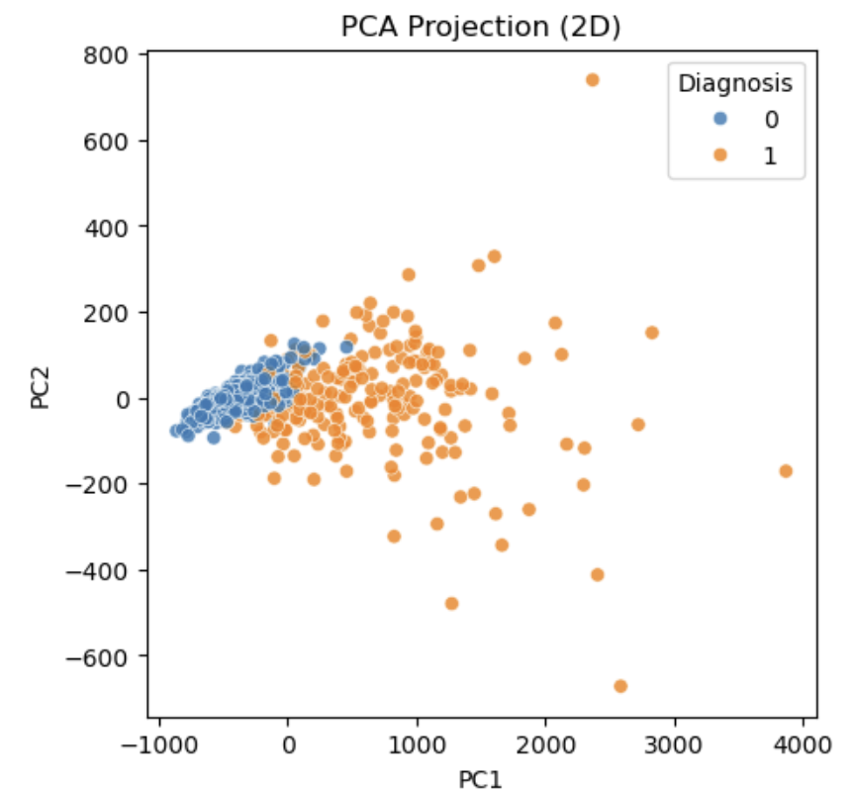
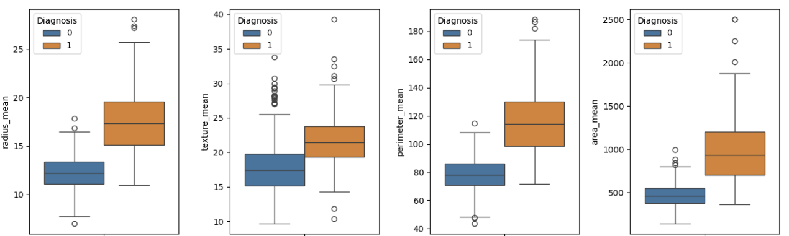
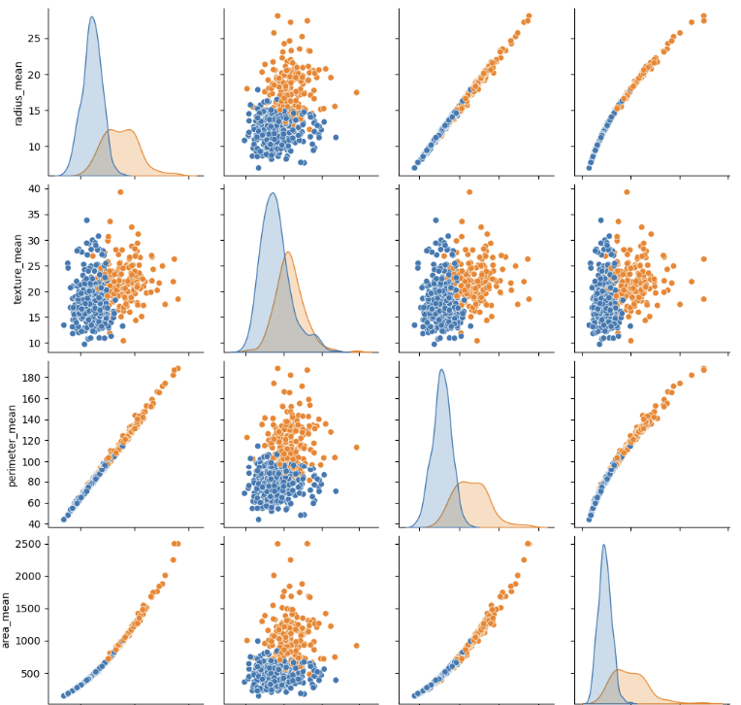
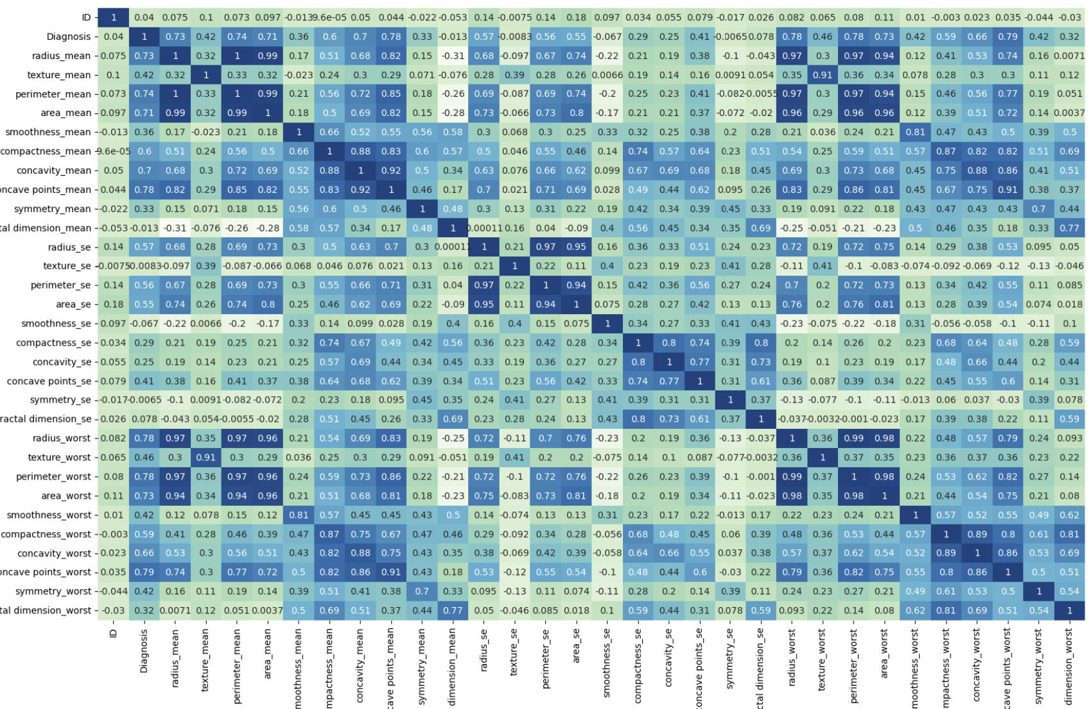
Exploratory data analysis and Pre-processing
Described the data set
Box plot to analyze outliers
Scatter Plot and Heat Map
Interpretation
PCA to visualize class separability
No missing/null values or duplicate values
Slightly imbalanced to benign
The data has outliers
Scaling might be needed
Shows strong positive correlation between radius, perimeter and area
Dataset is not linearly separable
Interpretation
Strong correlation between parameters
Dataset is slightly imbalanced
Malignant (M): ~37% & Benign (B): ~63%
Outliers present for which robust scaling will be done.
Data is not linearly separable
High feature correlation observed between radius, perimeter and area

Slide 4
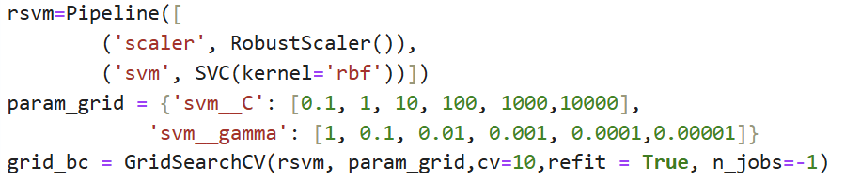
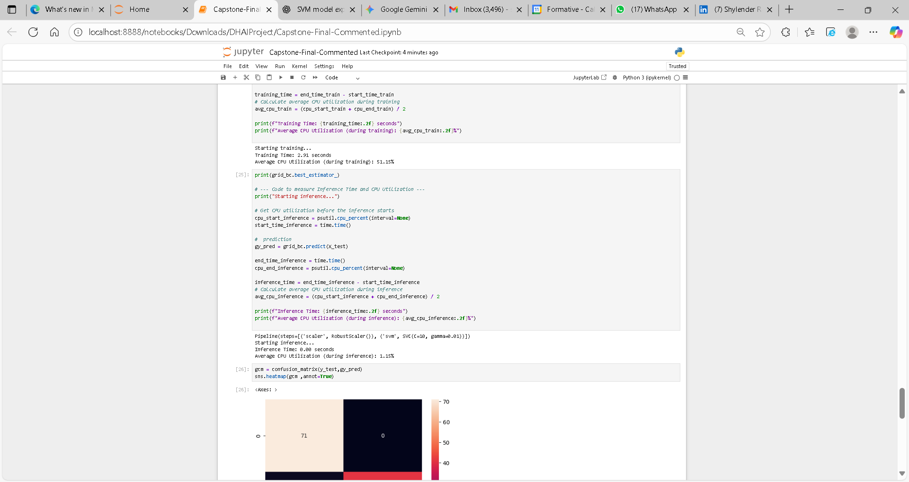
Model Selection and Training
Pre-Processing
This approach was chosen as RBF works well with non-linear and high-dimensional data
Dataset loaded into Pandas dataframe
Data cleaning done
Target variable is encoded(1 = Malignant, 0 = Benign)
Dataset separated into features and target
Data split into Train and Test set (80:20)
Model Code
Models chosen and rationale
SVM with RBF Kernel –RBF kernel used as the dataset is not linearly separable and it can model the complex interactions between the features.
SciKit Pipeline used to scale before training in each iteration.
RobustScaler to handle outliers.
GridSearchCV for hyperparameter tuning.
Cv=10 - 10 fold validation to prevent overfitting and enhances model robustness.
Time Taken and Utilization
i7-12700H Processor; 2.30 GHz clock speed; 32.0 GB RAM ; no GPU used

Slide 5
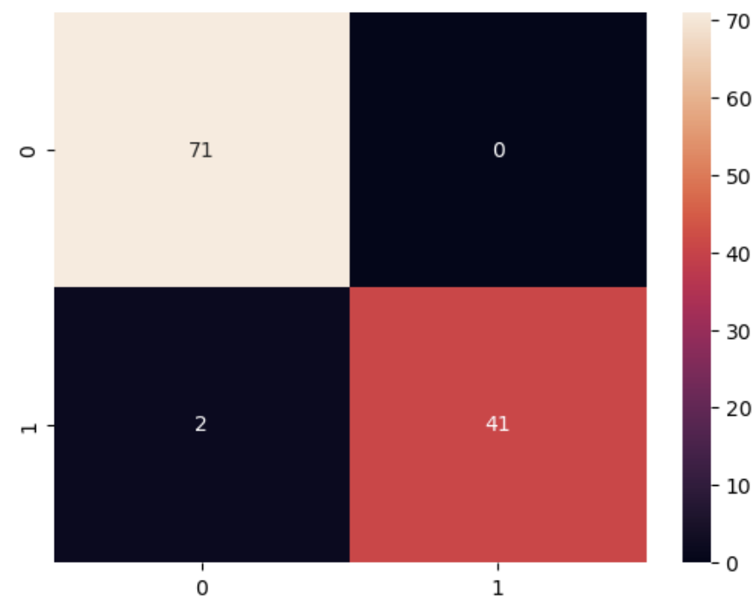
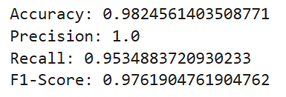
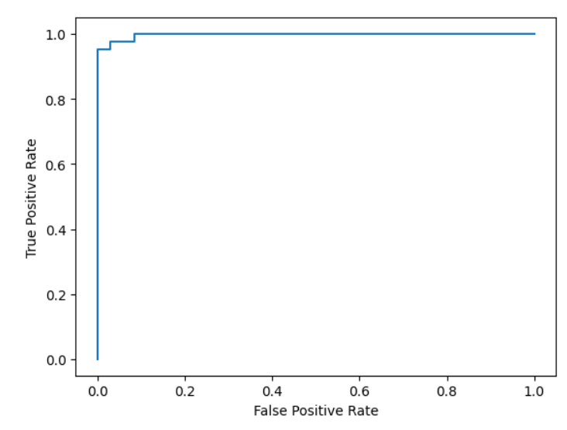
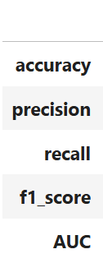
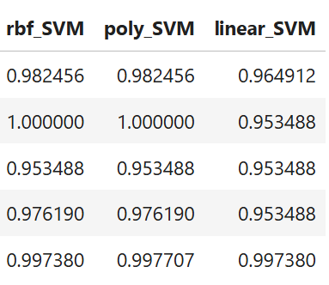
Model Evaluation & Results
Results
True Negative
False Positive
Only 2 False negatives out of 114 cases
False Negative
True Positive
ROC Curve for SVM Classifier

Slide 6
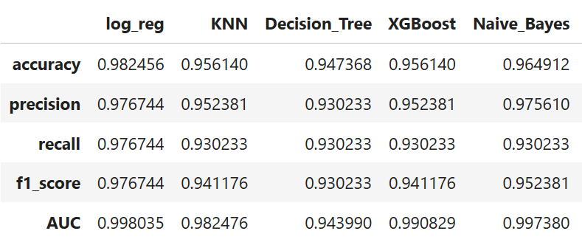
Inferences
Inferences:
SVM with rbf kernel performed well with 98.24 % accuracy.
Typical accuracy of clinician is ~95% and the model here gave a higher accuracy.
Typical clinician/pathologist requires 1-2 days to report FNAC but the model required <1 second (~12ms) to predict values.
Other approaches tried

Slide 7
Thank You !

